Slide 1
Fraud Trends
Rebekah Higgins, Vice President - Payments

Slide 2
agenda
Fraud stats
Transaction flow
Common types of fraud
Prevention tools
Tips and tricks
Questions

Slide 3
Fraud stats

Slide 4
New Threats Are Emerging Every Day
Fraud is costly and complex than ever with no slow down in sight
$6 Billion
Annual cost to lenders due to synthetic IDs
$56 Billion
Reported identity fraud across 49 million consumers
80%
of financial crime schemes are driven by organized crime
Before the Transaction
During the Transaction
After the Transaction
$6 Trillion
Cybercrime damage annually
$382 Million
Fraud linked to COVID in the United States
4.2 Billion
Records breached in the past year

Slide 5
Fraud versus friction
One in 6 U.S. consumers experiences a false decline
15% of consumers will reduce their spending with one false decline
20% of consumers with more than one false decline stop using that card.
One in 6 U.S. consumers experiences a false decline
15% of consumers will reduce their spending with one false decline
20% of consumers with more than one false decline stop using that card.

Slide 6
Transaction flow

Slide 7
Who are the players?
Consumer
Merchant/Acquirer
Processor for the Merchant/Acquirer
Networks
EFT Processor for Issuer
Set the rules and standards for transaction processing
Provide connectivity between merchant and issuer
Settlement of funds
Governance of structure - disputes
Gateway for transaction processing
Consolidator for card issuers
Want access to funds
Want to move or to get money
Provides goods and/or services to consumer
Facilitates transaction from merchant terminal
Reviews routing tables to determine which network to route transaction
Core/Host Processing System
Keeper of consumer account
Gateway for transaction processing

Slide 8
Point of sale Transaction
Merchant Processing System
Issuer Processor
Core/Host Processor
Network

Slide 9
Common types of fraud

Slide 10
Common types of fraud
Phishing, smishing, vishing
Card Fraud
Identity theft
Account takeover
Cyber fraud
Synthetic fraud

Slide 11
Phishing/Smishing/vishing
Fraudsters design scams to lure unsuspecting people into revealing sensitive information
Commonly completed via fake emails, text messages, links, cloned websites, phone calls and pop-up windows that appear legitimate
Motivated to gather card data to perform purchases and/or transfer money into another account
Commonly linked to account take over and card fraud

Slide 12
Card fraud – BIN Brute force attacks
Targets the for six-eight digits of the card number or Bank Identification Number (BIN) used to identify a card issuer
Sophisticated software programs are used to randomly generate the remaining digits of a specific card number in various combinations
Small, online transactions are completed to identify open/active cards
Software algorithms are used to perform test runs at a high velocity with the same purchase amounts, expiration dates and CVV codes in various combinations
Once successful, a card will be used at a multitude of merchants for larger dollar amounts

Slide 13
Card fraud – Card cracking
Consumer responds to an online solicitation for “easy money” by providing card information to withdraw fake check deposits
Target audience is typically consumers between the ages of 19-25, college students, newly enlisted military and single parents
Victims quickly become accomplices by providing card data including PIN and online credentials to provide access to their accounts
Fraudster deposits worthless checks via mobile deposit and then immediately withdraws funds at an ATM
Cardholder reports card stolen, receives reimbursement and fraudster shares portion of proceeds with them.

Slide 14
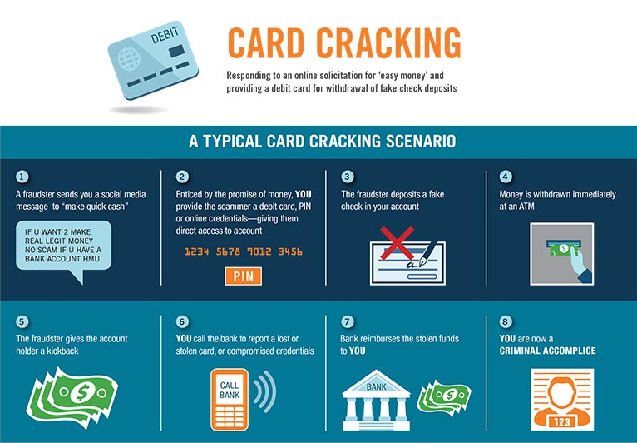
Card Fraud

Slide 15
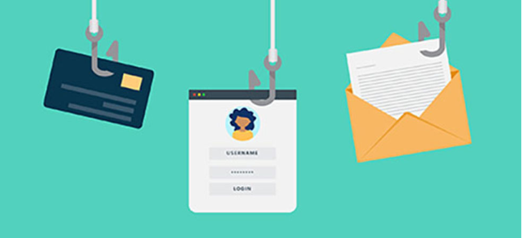
Identity theft
Occurs when someone steals personal or financial information to commit fraud or other crimes
Typically goes beyond card fraud and involves personally identifiable information (PII)
More difficult to identify than card fraud
No liability limit
Can last for an extensive period of time

Slide 16
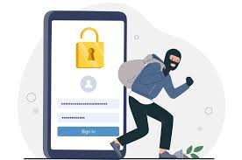
Account take over fraud
Occurs when someone gains access to a victim’s login credentials to steal funds and information
Linked to other forms of fraud
Begins with the harvesting of personal information via data breaches or purchasing on the Dark Web
Fraudsters change account information, password, and notifications so legitimate owner is not aware of activity on the account
Ends with fraudulent and unauthorized transactions

Slide 17
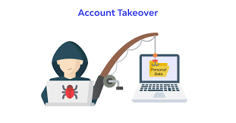
Methods for Account take over fraud
Phishing
Credential stuffing
SIM card swapping
Malware
Mobile banking trojans
Man-in-the-middle attacks

Slide 18
Cyber fraud
Crimes committed via the internet with the intent corrupt another individual’s personal and financial information stored online
Popular forms of Cyber Fraud
Malware
Ransomware
DDoS Attacks
Email scams

Slide 19
Synthetic fraud
Real Social Security Number (SSN) is stolen, and then personal information is made up and applied to create a new identity
Common victims include children, the elderly and homeless individuals due to lack of credit monitoring
Manipulated Synthetics – based on real identity with limited changes to SSN and other PII
Manufactured Synthetics – valid data from multiple identities or invalid data

Slide 20
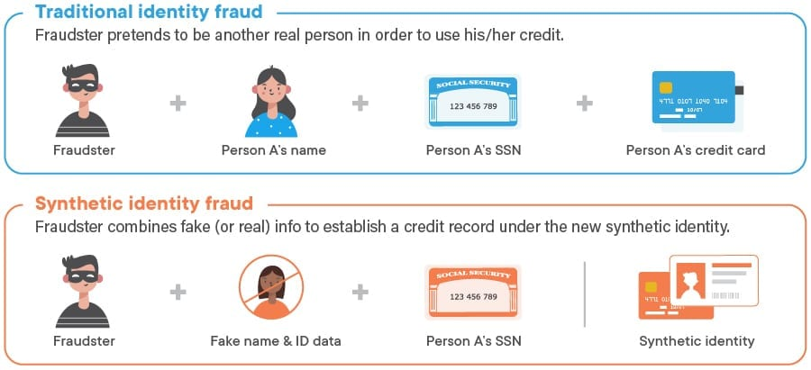
Synthetic fraud

Slide 21
Prevention tools

Slide 22
Before the Transaction
After the Transaction
Before the Transaction
During the Transaction
After the Transaction
During the Transaction
EMV
Step Up Authentication
3D Secure 2.0
Card Controls
Dark Web Monitoring
BIN level transaction monitoring
100% real-time scoring
Behavior-based algorithms to detect fraudulent transactions
Credit union-defined, multi-channel consumer notifications
Feedback loop into platform-wide consortium model
Case management tools to manage fraud
Consulting
Reporting

Slide 23
EMV

Slide 24
Step up authentication
What Is Step Up?
A unique one-time passcode sent to the cardholder
Used when contacting call centers for high-risk call types
Can also be initiated by the FI
Benefits
Securely authenticates the cardholder
Uses technology the cardholder uses daily and is familiar with
Call Types
Manual Activations
Fraud case response without unique case #
Digital wallet provisioning

Slide 25
3D Secure
“Zero Touch” Consumer Experience
Eliminates need for password, merchant enrollment, activation during shopping
“Zero” interaction from cardholder provides frictionless experience
Industry-leading risk engine rules, neural network models
Real-time behavioral analytics
Payment Risk Analytics Provides Advanced Security
Multi-component, multi-channel risk assessment
Self-learning behavioral fraud detection model
Instant case management and reporting
Spot and isolate devices with suspicious activity used in multiple transactions
Benefits
Increases interchange revenue
Decreases losses
Reduced risk exposure
Reduced abandonment rates
Frictionless online payment experience
No cardholder registration, challenge questions

Slide 26
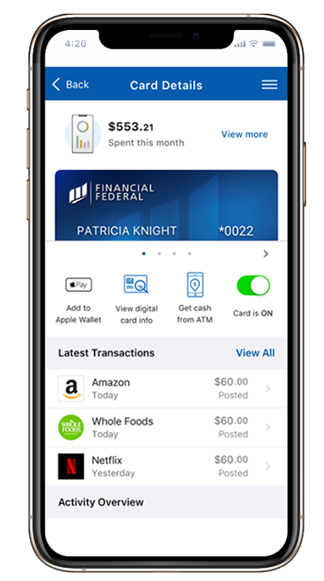
Card controls
Most effective when embedded into mobile and online banking and fully branded by financial institution
Connected experiences across web and mobile
Wide range of features to help mitigate fraud:
Lock & Unlock Card
Set Controls & Alerts
Create a Travel Plan
Click to Disable Card
Receive Fraud Alerts

Slide 27
Rule writing tips
Rules to Avoid
Too targeted
Too broad
Aimed at stopping activity unrelated to fraud
Velocity or timer rules
Good Rules
Address a specific type of fraud that affects a large number of cards, while showing a low, projected false positive ratio
Are broad or wide-scope, only if based on actual transaction data and show a low projected false positive ratio
Use a narrow-scope to stop very specific fraud events

Slide 28
Tips and tricks

Slide 29
Tips and Tricks
Require random or complex passwords for cardholders
When in doubt – call back
Randomize card numbers and expiration dates
Monitoring
Increased denials for invalid expiration date, invalid CVV in short time periods
Setting transaction limits
Daily spend
Velocity
Staff authority
Educate, educate, educate

Slide 30
Additional thoughts and questions…..

