Slide 1
New England Fraud Trends
May 12, 2023

Slide 2
WWW.IC3.GOV

Slide 3
Filing a Complaint

Slide 4
Financial Fraud Kill Chain

Slide 5
2021 IC3.GOV National Crime Statistics
Total Victim Losses: $6.9 Billion
Daily Reports Filed: 2,300
Largest Victim Demographic: Individuals 60 and older
Total Reports: 92,371
Losses: $1.68 Billion
Loss Increase Up From 2020: 74%
These statistics only account for incidents REPORTED to www.ic3.gov.

Slide 6
IC3 Recovery Asset Team (RAT)
73% success rate in loss recovery
Total Incidents: 2,838
$590.62 Million in Losses
$433.30 Million Frozen
* These figures only represent reported incidents that fall within certain criteria that trigger notification to the appropriate financial institution.

Slide 7
2021 IC3.GOV New England Statistics
Total Victim Reports: 11,363
Total Victim Losses: $292.5 Million
* Includes Maine, Massachusetts, New Hampshire and Vermont

Slide 8
Prominent Cyber Frauds
Business Email Compromise (BEC/EAC)
Romance/Confidence Scams
Crypto Investment
Malware
Tech Support
FI Account Compromise
Elder Fraud (all encompassing)

Slide 9
Business Email Compromise
Primary Targets:
Real estate closing entities such as title companies and attorneys
Healthcare institutions
Local municipalities
Businesses that regularly pay invoices to non-local/out of state contractors
Non-profits (e.g. Portland non-profit)
New England 2021 Stats
Reports filed: 720
Victim Losses: $71.7 Million

Slide 10
Romance/Confidence Scams
Primary Targets:
Divorcees
Widows and widowers
Socially/geographically isolated
Elderly
* This crime is highly under-reported and is extremely common.
New England 2021 Stats
Reports Filed: 596
Victim Losses: $23.7 Million

Slide 11
Tech Support
Primary Targets:
Elderly (46% of total victims; 69% of total loss)
High net worth individuals
Individuals with IRAs/retirement accounts
New England 2021 Stats
Reports Filed: 794
Victim Losses: $7.6 Million

Slide 12
Elder Fraud
Elder fraud is an existential threat.
* This is cyber-enabled/interstate fraud, and typically does not include relative/guardian-related elder fraud.
National 2021 Stats
Reports Filed: 88,262
Victim Losses: $3.1 Billion
New England 2021 Stats
Reports Filed: 2,672
Victim Losses: $103.2 Million

Slide 13
Why the rise in elder fraud?
1. The U.S. has seen a steady rise in our elderly population (15% currently; 20% by 2030) due to longer life span, better healthcare, growing wealth, etc.
2. The baby boomer generation prospered after World War II and amassed greater wealth than any prior generation.
3. Broad internet access and the proliferation of anonymizing apps give criminals the ability to reach across borders to victimize U.S. citizens.
4. Data breaches have exposed personal information, which is sold on the dark web.
5. Elderly are typically higher net worth, more trusting, less conflict adverse, and law abiding.

Slide 14
Elderly and Tech Support
Numerous incidents of elderly victims in New England falling prey to tech support scams.
These scams have recently increased in number and loss amount per incident
Appear to be operating at a network level, to include call centers and money laundering networks
Subjects use various tactics and tools, including external stimuli (loud alarms) and remote desktop software (to access victim computer and to mask IP logins)
Common theme is convincing the victim that their financial institution is stealing from their accounts
Victims withdraw funds from financial institution and deposit it into cryptocurrency accounts

Slide 15
Preventative Steps
Stay current and educate yourself regarding fraud schemes by visiting www.ic3.gov and www.usa.gov.
Regularly monitor your bank, investment, and credit accounts for unusual activity.
Freeze your credit (It’s free!)
Do not answer calls from unknown telephone numbers and NEVER provide your personal information over the phone to unverified callers.
Stay active and engaged with family and community and relay unusual interactions to family and friends for a second opinion.

Slide 16
Wire Recall Procedure
Knowing the wire recall process and being able to implement it quickly is imperative in order to recover victim funds.
Steps to take if you are made aware of a fraudulent wire (IN THIS ORDER):
Immediately call your financial institution and request that it issue a wire recall notice to the recipient FI.
File a detailed complaint (to include all wire transfer info) on www.ic3.gov. This will initiate the financial fraud kill chain between the FBI and the recipient bank (dependent on timeframe and wire amount).
Contact the fraud department of recipient bank by telephone and email.
File local police report and obtain an incident number.

Slide 17
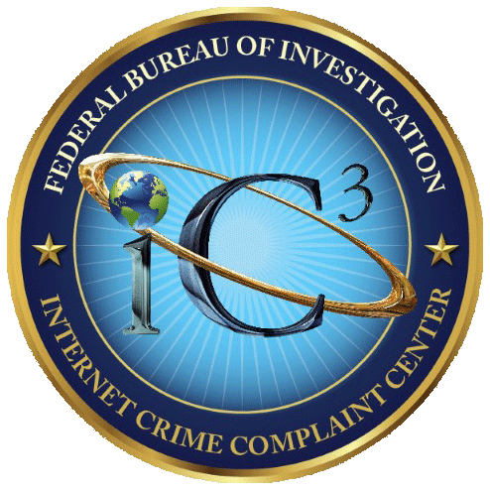
Questions?
SA Andy Drewer
FBI, Boston Division, Portland, Maine Resident Agency
100 Middle Street, West Tower, 4th Floor, Portland, ME 04101
Direct Line: 207-541-0705
Email: adrewer@fbi.gov
* File reports via www.ic3.gov

